Slide 1
Social Value

Slide 2
What is Social Value?
Social Value is a concept that refers to the positive impact that public services and businesses can have on the wellbeing of individuals, communities and the environment (Local Government Association).
[A] real opportunity to leverage our annual buying power to achieve meaningful outcomes for local people.
If £1 is spent on the delivery of services, can that same £1 be used also to produce a wider benefit to the community?

Slide 3
Outline of Social Value at LBHF
LBHF’s Social Value policy is divided into six main themes which correlate to its six core values:
Building a shared prosperity
Doing things with residents, not to them
Creating a compassionate council
Taking pride in Hammersmith & Fulham
Climate change
Promoting social innovation

Slide 4
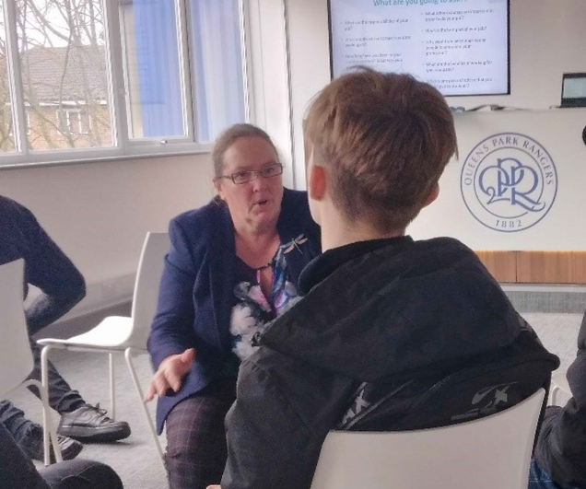
Some examples:
Volunteers gardening and estate clearing
Sustainability and biodiversity talks at primary schools
Interacting with ‘NEETs’ around careers in construction

Slide 5
Some examples:
Refurbishing a care-leavers’ hub
Redecorating homes

Slide 6
Questions
What are the priority areas for White City in terms of Social Value?
How can we turn these priorities into workable Social Value suggestions?

Slide 7
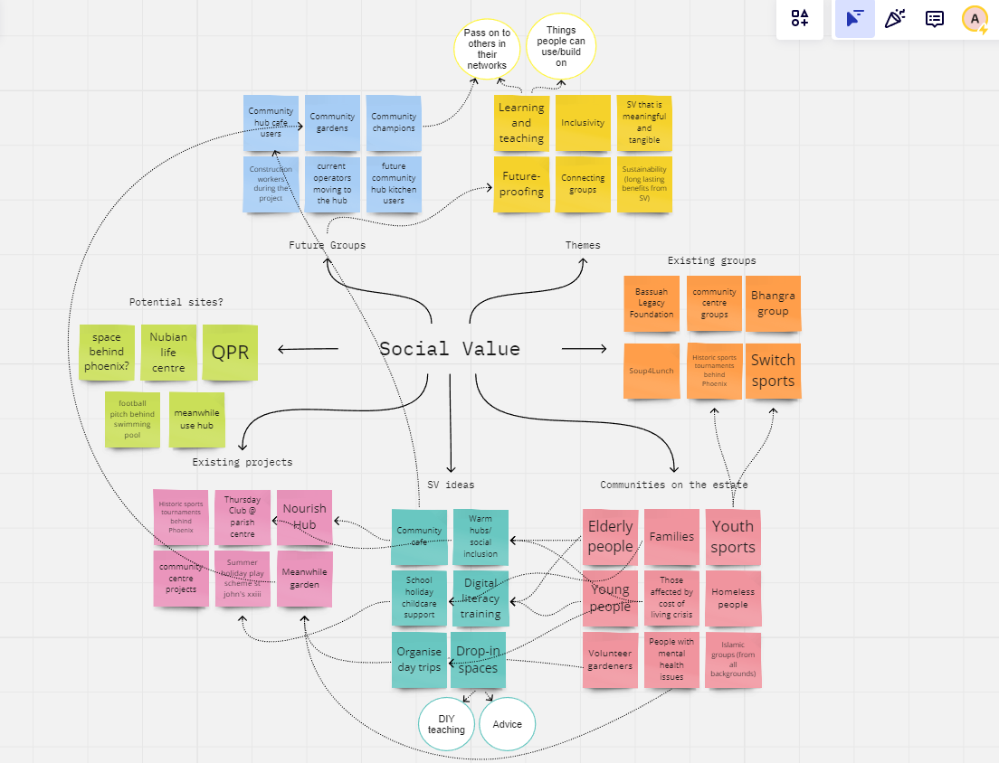
Notes:
Themes from this discussion: Residents want social value initiatives that are meaningful, flexible and sustainable for the community
The discussion ranged from current groups delivering meaningful services in the area, and considering communities that would benefit from social value proposals.
Themes that came out of the mind map included teaching and learning, inclusivity, connecting groups, future-proofing services and looking ahead for how the new community hub will be sed, and ensuring that the social value is meaningful and tangible.

Slide 8
Themes from the mind map
Teaching and learning
Inclusivity
Connecting groups
Future-proofing services and looking ahead to how the new community hub will be used
Sustainability
Ensuring that the social value is meaningful and tangible.
Notes:
Themes from this discussion: Residents want social value initiatives that are meaningful, flexible and sustainable for the community
The discussion ranged from current groups delivering meaningful services in the area, and considering communities that would benefit from social value proposals.
Themes that came out of the mind map included teaching and learning, inclusivity, connecting groups, future-proofing services and looking ahead for how the new community hub will be sed, and ensuring that the social value is meaningful and tangible.

Slide 9
Construction Working Group
Website: www.whitecitycentral.com
Email: whitecitycentral@lbhf.gov.uk

